Slide 1


<Name>
<Date>

Slide 2

Outline
Executive Summary
Introduction
Methodology
Results
Conclusion
Appendix

Slide 3
Executive Summary
Use of SpaceX APIs and Web Scrapping to collect data.
Use of SQL and data visualization to gather insights.
Building an interactive dashboard to view the results.
Building a machine learning model to predict a successful landing.
Decision Tree model provides best results.

Slide 4
Introduction
The commercial space age is advancing rapidly, with companies like Virgin Galactic, Rocket Lab, Blue Origin, and notably, SpaceX, making space travel more affordable and accessible.
SpaceX, with its groundbreaking achievements such as sending spacecraft to the International Space Station, developing the Starlink satellite internet constellation, and conducting manned space missions, stands out due to its cost-effective approach.
A significant factor in SpaceX's affordability is the reusability of the Falcon 9 rocket's first stage, reducing launch costs to 62 million dollars compared to competitors' 165 million dollars per launch.
The primary goal is to determine the cost of each rocket launch and predict the reusability of the first stage.

Slide 5

Section 1

Slide 6
Methodology
Executive Summary
Data collection methodology:
Using REST API and Beautiful Soup
Perform data wrangling
Filtering Falcon 9 data and handling null values
Perform exploratory data analysis (EDA) using visualization and SQL
Perform interactive visual analytics using Folium and Plotly Dash
Perform predictive analysis using classification models
How to build, tune, evaluate classification models

Slide 7
Data Collection
In this project, we gather SpaceX launch data using the SpaceX REST API, specifically from the ‘api.spacexdata.com/v4/launches/past’ endpoint. We use the `requests` library to perform GET requests and obtain JSON responses, which are then converted into pandas DataFrames using the `json_normalize` function. Additionally, we use BeautifulSoup to scrape supplementary Falcon 9 launch data from Wikipedia.
We clean and prepare the data for analysis by handling identification numbers with additional API calls, filtering out Falcon 1 launches, and addressing null values. For example, we replace null values in the `PayloadMass` column with the calculated mean. Columns like `LandingPad` with null values are left for later processing using one-hot encoding. This ensures a comprehensive and usable dataset for analysis.

Slide 8
Data Collection – SpaceX API
GET Request from Rest API
JSON Object
Pandas Dataframe
Source: SpaceX REST API and web scraping from Wikipedia.
Tools: ‘requests’ library for API calls, BeautifulSoup for web scraping.
Data Format: JSON, converted to pandas DataFrame using ‘json_normalize’.
URL:

Slide 9
Data Collection - Scraping
Parsing the table
Convert to pandas dataframe
Using BeautifulSoup to scrape data
Handling Identification Numbers: Additional API calls to fetch specific data for IDs (e.g., Booster, Launchpad, payload, core).
Filtering Data: Exclude Falcon 1 launches to focus on Falcon 9 data.
Replace null values in ‘PayloadMass’ with the column mean.
URL:

Slide 10
Data Wrangling
We need to identify patterns and create training labels for supervised machine learning models.
It involves tasks such as calculating the number of launches per site, the occurrence of each orbit type, and the mission outcomes.
The dataset includes various attributes like flight number, date, booster version, payload mass, and landing outcomes, among others. The final task is to create a binary classification label for landing success, with ‘1’ indicating a successful landing and ‘0’ for unsuccessful attempts.
URL:

Slide 11
EDA with Data Visualization
1. Flight Number vs. Payload Mass Scatter Plot: This chart was used to analyze the relationship between the flight number of SpaceX Falcon 9 launches and the payload mass. The overlay of launch outcomes helped to discern patterns, such as higher flight numbers potentially leading to more successful landings.
2. Flight Number vs. Launch Site Scatter Plot: This visualization aimed to explore the connection between the number of flights and the launch sites, with the success rate of landings indicated by different hues.
3. Payload vs. Launch Site Scatter Plot: This chart was created to observe if there's any correlation between the payload mass and the launch sites. Notably, it highlighted that heavier payloads have not been launched from the VAFB-SLC site.
4. Success Rate by Orbit Type Bar Chart: By grouping the data by orbit type and calculating the mean success rate, this bar chart provided insights into which orbits have higher success rates.
URL:
Notes:
Summarize what charts were plotted and why you used those charts
Add the GitHub URL of your completed EDA with data visualization notebook, as an external reference and peer-review purpose

Slide 12
EDA with Data Visualization
5. Flight Number vs. Orbit Type Scatter Plot: This plot aimed to reveal any trends between the flight number and the orbit type, suggesting that certain orbits like LEO might have a success rate correlated with the number of flights.
6. Payload vs. Orbit Type Scatter Plot: This chart was used to examine the relationship between payload mass and orbit type, indicating that heavier payloads tend to have a higher success rate in specific orbits like Polar, LEO, and ISS.
7. Launch Success Yearly Trend Line Chart: A line chart was plotted to show the trend of average launch success rates over the years, revealing an increasing trend in success since 2013.
These visualizations were chosen to facilitate exploratory data analysis, allowing for a better understanding of the factors that might influence the success of SpaceX Falcon 9 rocket landings. The use of scatter plots and bar charts helped to identify trends and correlations in the dataset effectively.
Notes:
Summarize what charts were plotted and why you used those charts
Add the GitHub URL of your completed EDA with data visualization notebook, as an external reference and peer-review purpose

Slide 13
EDA with SQL
Display Unique Launch Sites: Retrieve and display the distinct names of all launch sites used in the space missions.
Records with Launch Sites Starting with 'CCA': Select and display five records where the launch site names begin with the string 'CCA’.
Total Payload Mass for NASA (CRS) Boosters: Calculate and display the total payload mass carried by boosters associated with NASA's CRS missions.
Average Payload Mass for Booster Version F9 v1.1: Calculate and display the average payload mass carried by the booster version F9 v1.1.
First Successful Ground Pad Landing Date: Identify and display the date of the first successful landing on a ground pad.
URL:
Notes:
Using bullet point format, summarize the SQL queries you performed
Add the GitHub URL of your completed EDA with SQL notebook, as an external reference and peer-review purpose

Slide 14
EDA with SQL
Boosters with Successful Drone Ship Landings and Specific Payload Mass: List the names of boosters that have successfully landed on a drone ship and carried payload masses between 4000 and 6000 kg.
Total Successful and Failed Mission Outcomes: Count and display the total number of successful and failed mission outcomes.
Boosters with Maximum Payload Mass: Identify and display the names of booster versions that have carried the maximum payload mass.
Failure Landing Outcomes in Drone Ship for 2015: Retrieve and display records showing the month names, failure landing outcomes on drone ships, booster versions, and launch sites for the year 2015.
Rank Landing Outcomes by Count (2010-06-04 to 2017-03-20): Rank and display the count of different landing outcomes (such as "Failure (drone ship)" or "Success (ground pad)") that occurred between the specified dates, in descending order of frequency.
Notes:
Using bullet point format, summarize the SQL queries you performed
Add the GitHub URL of your completed EDA with SQL notebook, as an external reference and peer-review purpose

Slide 15
Build an Interactive Map with Folium
URL:
Notes:
Summarize what map objects such as markers, circles, lines, etc. you created and added to a folium map
Explain why you added those objects
Add the GitHub URL of your completed interactive map with Folium map, as an external reference and peer-review purpose

Slide 16
Build a Dashboard with Plotly Dash
The Dashboard contains a dropdown to select the launch site to display the total successful launches by site.
For each individual site it displays the ratio of successful and unsuccessful launches.
It also includes to view the outcome for all site depending on Payload mass and booster version.
URL:
Notes:
Summarize what plots/graphs and interactions you have added to a dashboard
Explain why you added those plots and interactions
Add the GitHub URL of your completed Plotly Dash lab, as an external reference and peer-review purpose

Slide 17
Predictive Analysis (Classification)
Data Collection and Preprocessing: Gather relevant data for your classification task. Clean and preprocess the data by handling missing values, encoding categorical features, and scaling numerical features.
Feature Selection and Engineering: Identify important features that contribute to the target variable. Create new features if needed (e.g., combining existing features, extracting information).
Split Data into Train and Test Sets: Divide the dataset into training and testing subsets (e.g., 70% train, 30% test).
Choose a Classification Algorithm: Select an appropriate algorithm based on the problem (e.g., logistic regression, decision tree, random forest, support vector machine, neural network).
Model Training: Fit the chosen model to the training data. Adjust hyperparameters (if applicable).
Notes:
Summarize how you built, evaluated, improved, and found the best performing classification model
You need present your model development process using key phrases and flowchart
Add the GitHub URL of your completed predictive analysis lab, as an external reference and peer-review purpose

Slide 18
Predictive Analysis (Classification)
Model Evaluation: Evaluate the model’s performance using metrics such as accuracy, precision, recall, F1-score, and ROC curve. Use the test set to assess how well the model generalizes.
Iterate and Improve: If the model performs poorly, consider: Trying different algorithms. Tuning hyperparameters. Addressing class imbalance. Feature selection/refinement.
Select the Best Model: Compare multiple models based on evaluation metrics. Choose the one with the best trade-off between bias and variance.
Deployment and Monitoring: Deploy the selected model in a production environment. Monitor its performance over time and retrain if necessary.
Notes:
Summarize how you built, evaluated, improved, and found the best performing classification model
You need present your model development process using key phrases and flowchart
Add the GitHub URL of your completed predictive analysis lab, as an external reference and peer-review purpose

Slide 19
Results
Exploratory data analysis results
Interactive analytics demo in screenshots
Predictive analysis results

Slide 20

Section 2

Slide 21
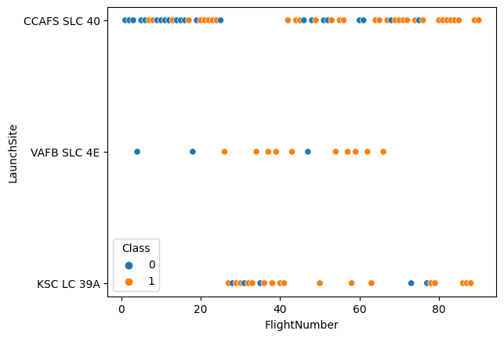
Flight Number vs. Launch Site
Show a scatter plot of Flight Number vs. Launch Site
Show the screenshot of the scatter plot with explanations

Slide 22
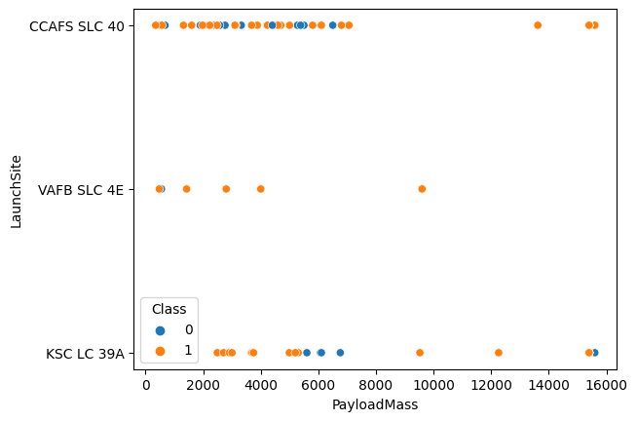
Payload vs. Launch Site
Show a scatter plot of Payload vs. Launch Site
Show the screenshot of the scatter plot with explanations

Slide 23
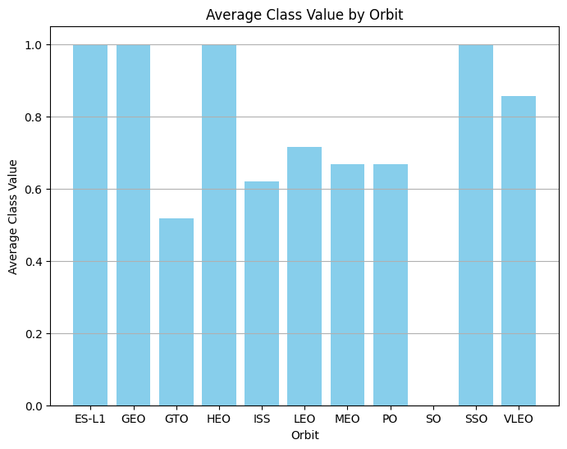
Success Rate vs. Orbit Type
Show a bar chart for the success rate of each orbit type
Show the screenshot of the scatter plot with explanations

Slide 24
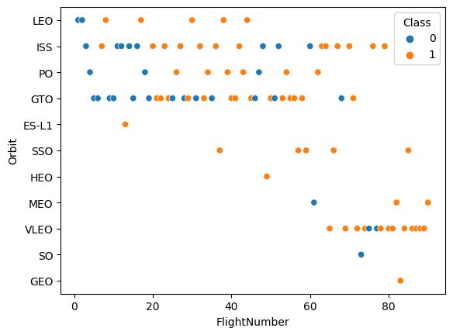
Flight Number vs. Orbit Type
Show a scatter point of Flight number vs. Orbit type
Show the screenshot of the scatter plot with explanations

Slide 25
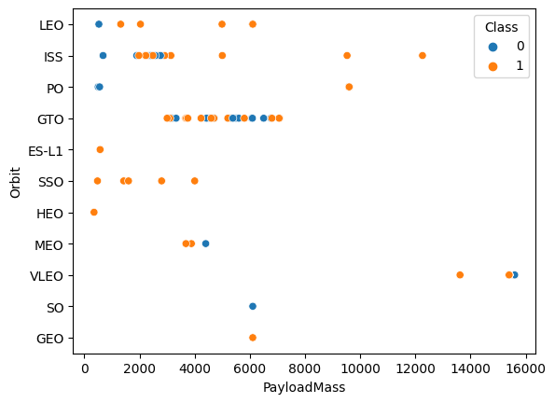
Payload vs. Orbit Type
Show a scatter point of payload vs. orbit type
Show the screenshot of the scatter plot with explanations

Slide 26
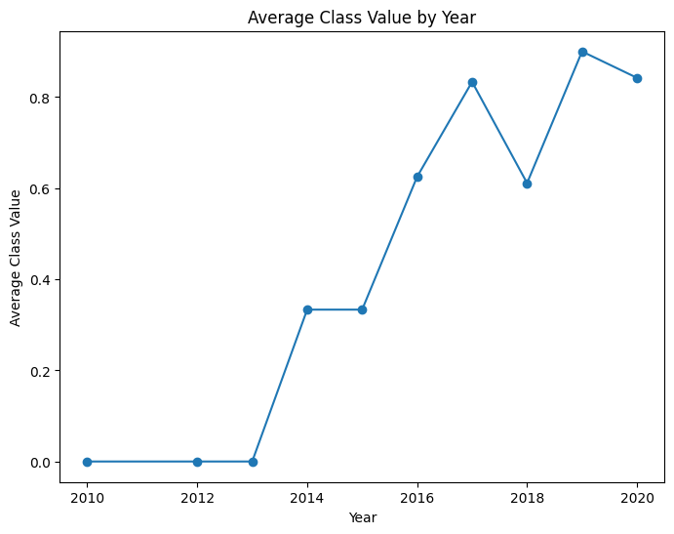
Launch Success Yearly Trend
Notes:
Show a line chart of yearly average success rate
Show the screenshot of the scatter plot with explanations

Slide 27
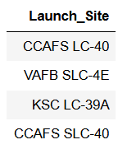
All Launch Site Names
Find the names of the unique launch sites
Present your query result with a short explanation here

Slide 28
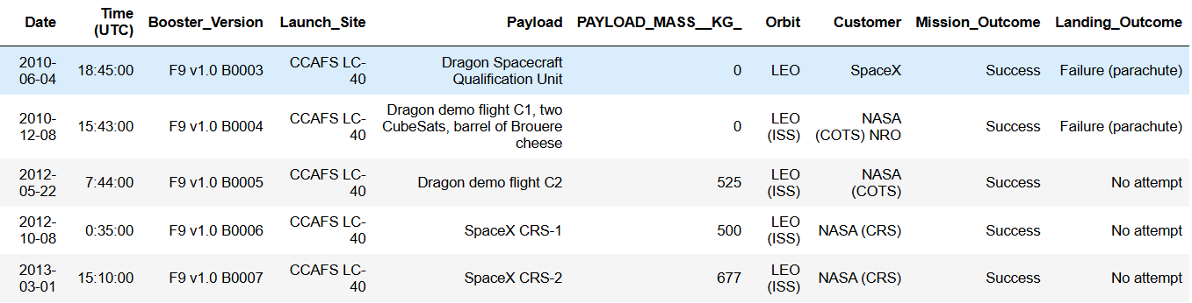
Launch Site Names Begin with 'CCA'
Notes:
Find 5 records where launch sites begin with `CCA`
Present your query result with a short explanation here

Slide 29
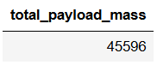
Total Payload Mass
Calculate the total payload carried by boosters from NASA
Present your query result with a short explanation here

Slide 30
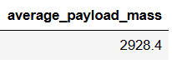
Average Payload Mass by F9 v1.1
Calculate the average payload mass carried by booster version F9 v1.1
Present your query result with a short explanation here

Slide 31
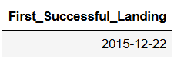
First Successful Ground Landing Date
Find the dates of the first successful landing outcome on ground pad
Present your query result with a short explanation here

Slide 32
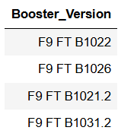
Successful Drone Ship Landing with Payload between 4000 and 6000
List the names of boosters which have successfully landed on drone ship and had payload mass greater than 4000 but less than 6000
Present your query result with a short explanation here

Slide 33
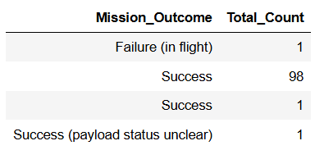
Total Number of Successful and Failure Mission Outcomes
Calculate the total number of successful and failure mission outcomes
Present your query result with a short explanation here

Slide 34
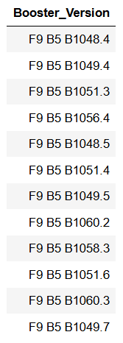
Boosters Carried Maximum Payload
List the names of the booster which have carried the maximum payload mass
Present your query result with a short explanation here

Slide 35
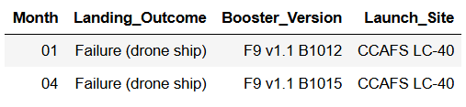
2015 Launch Records
List the failed landing_outcomes in drone ship, their booster versions, and launch site names for in year 2015
Present your query result with a short explanation here

Slide 36
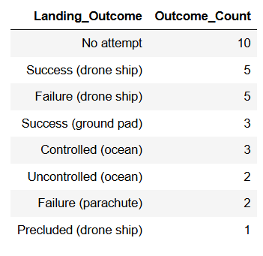
Rank Landing Outcomes Between 2010-06-04 and 2017-03-20
Rank the count of landing outcomes (such as Failure (drone ship) or Success (ground pad)) between the date 2010-06-04 and 2017-03-20, in descending order
Present your query result with a short explanation here

Slide 37

Section 3

Slide 38
<Folium Map Screenshot 1>
Replace <Folium map screenshot 1> title with an appropriate title
Explore the generated folium map and make a proper screenshot to include all launch sites’ location markers on a global map
Explain the important elements and findings on the screenshot

Slide 39
<Folium Map Screenshot 2>
Replace <Folium map screenshot 2> title with an appropriate title
Explore the folium map and make a proper screenshot to show the color-labeled launch outcomes on the map
Explain the important elements and findings on the screenshot

Slide 40
<Folium Map Screenshot 3>
Replace <Folium map screenshot 3> title with an appropriate title
Explore the generated folium map and show the screenshot of a selected launch site to its proximities such as railway, highway, coastline, with distance calculated and displayed
Explain the important elements and findings on the screenshot

Slide 41

Section 4

Slide 42
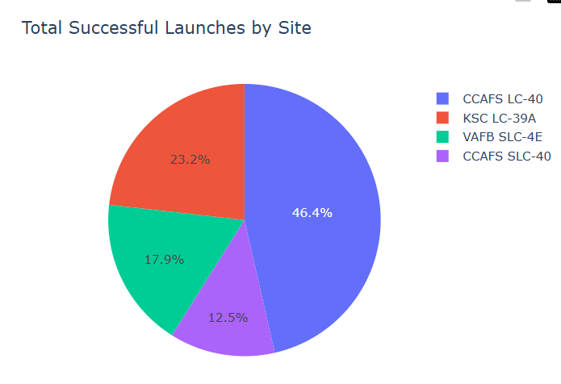
Successful Launches for all Sites
As we can observe the blue region which corresponds to ‘CCAFS LC-40’ has high success rates.

Slide 43
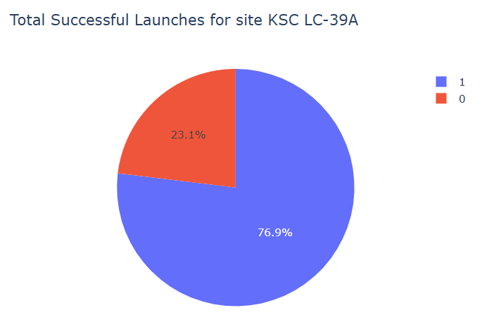
Launch site with highest success rate
Blue (1) indicates the successful launches.
Red (0) indicates the unsuccessful launches.

Slide 44
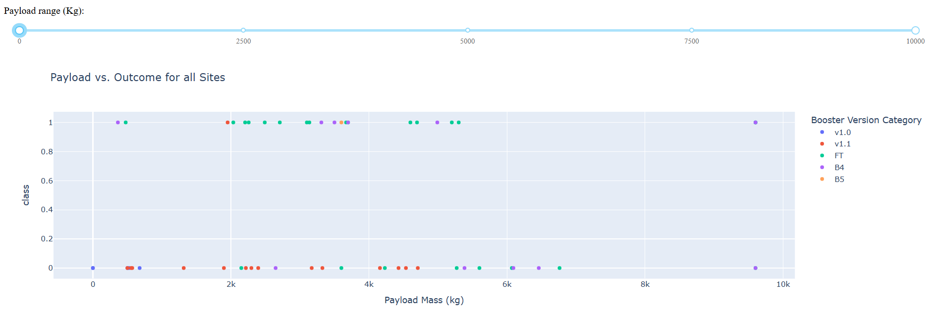
Payload Mass vs. Success rate
Notes:
Replace <Dashboard screenshot 3> title with an appropriate title
Show screenshots of Payload vs. Launch Outcome scatter plot for all sites, with different payload selected in the range slider
Explain the important elements and findings on the screenshot, such as which payload range or booster version have the largest success rate, etc.

Slide 45

Section 5

Slide 46
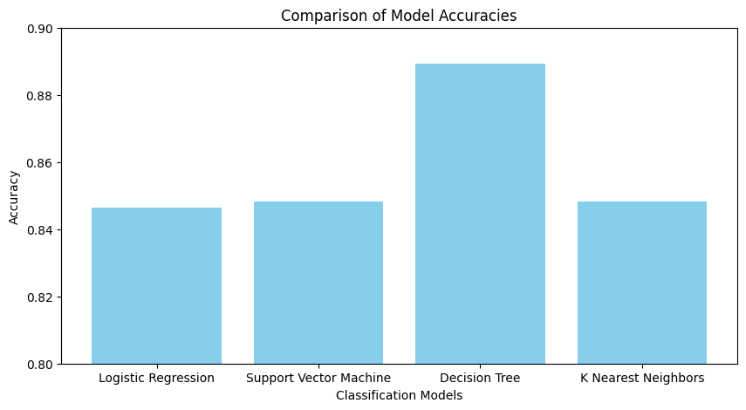
Classification Accuracy
Decision Tree model results in best accuracy.

Slide 47
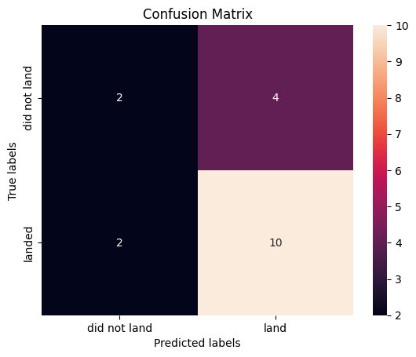
Confusion Matrix
Out of 6 negative samples (did not land) and 12 positive samples (landed), our model predicted 2 negative samples and 10 positive samples accurately.

Slide 48
Conclusions
Point 1
Point 2
Point 3
Point 4
…

Slide 49
Appendix
Include any relevant assets like Python code snippets, SQL queries, charts, Notebook outputs, or data sets that you may have created during this project

Slide 50


